Slide 1
Pipelined Execution Representation
Time
IFtch
Dcd
Exec
Mem
WB
IFtch
Dcd
Exec
Mem
WB
IFtch
Dcd
Exec
Mem
WB
IFtch
Dcd
Exec
Mem
WB
IFtch
Dcd
Exec
Mem
WB
IFtch
Dcd
Exec
Mem
WB
Every instruction must take same number of steps
also called pipeline “stages”
some instructions (shorter) will go idle in some stages
5 stage pipeline => 5 instructions executing simultaneously, one at each pipeline stage

Slide 2
Graphical Pipeline Diagrams
rd
PC
instruction
memory
registers
rs
Data
memory
rt
ALU
+4
imm
2. Decode/
Register Read
1. Instruction
Fetch
5. Write Back
3. Execute
4. Memory
Use datapath figure below to represent pipeline
IFtch
Dcd
Exec
Mem
WB
I$
Reg
ALU
D$
Reg

Slide 3
Graphical Pipeline Representation
Time (clock cycles)
I
n
s
t
r.
O
r
d
e
r
Load
I$
Reg
ALU
D$
Reg
Instr 1
I$
Reg
ALU
D$
Reg
Instr 2
I$
Reg
ALU
D$
Reg
Instr 3
I$
Reg
ALU
D$
Reg
Instr 4
I$
Reg
ALU
D$
Reg

Slide 4
Pipeline Performance
Assume time for stages is
100ps for register read or write
200ps for other stages
What is pipelined clock rate?
Compare pipelined datapath with single-cycle datapath
Instr | Instr fetch | Register read | ALU op | Memory access | Register write | Total time
lw | 200ps | 100 ps | 200ps | 200ps | 100 ps | 800ps
sw | 200ps | 100 ps | 200ps | 200ps |  | 700ps
R-format | 200ps | 100 ps | 200ps |  | 100 ps | 600ps
beq | 200ps | 100 ps | 200ps |  |  | 500ps

Slide 5
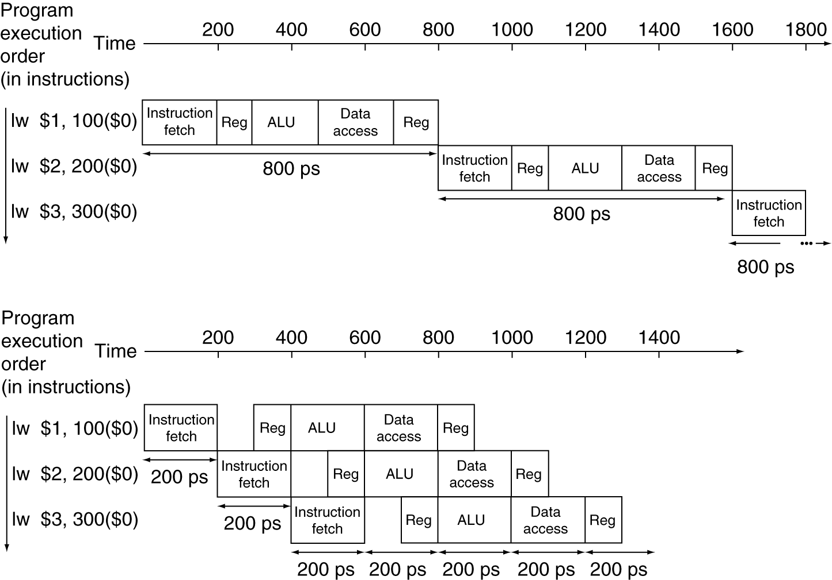
Pipeline Performance
Single-cycle (T_{c}= 800ps)
Pipelined (T_{c}= 200ps)

Slide 6
Pipeline Speedup
If all stages are balanced
i.e., all take the same time
Time between instructions_{pipelined} = Time between instructions_{nonpipelined} Number of stages
If not balanced, speedup is less
Speedup due to increased throughput
Latency (time for each instruction) does not decrease

Slide 7
Hazards
Situations that prevent starting the next logical instruction in the next clock cycle
Structural hazards
Required resource is busy (e.g., roommate studying)
Data hazard
Need to wait for previous instruction to complete its data read/write (e.g., pair of socks in different loads)
Control hazard
Deciding on control action depends on previous instruction (e.g., how much detergent based on how clean prior load turns out)

Slide 8
1. Structural Hazard #1: Single Memory
Load/Store requires memory access for data
Instruction fetch would have to stall for that cycle
Causes a pipeline “bubble”
Solution, provide separate cache for I$ and for D$
Time (clock cycles)
I
n
s
t
r.
O
r
d
e
r
Load
I$
Reg
ALU
D$
Reg
Instr 1
I$
Reg
ALU
D$
Reg
Instr 2
I$
Reg
ALU
D$
Reg
Instr 3
I$
Reg
ALU
D$
Reg
Instr 4
I$
Reg
ALU
D$
Reg
Read same memory twice in same clock cycle
Conflict for use of a resource

Slide 9
1. Structural Hazard #2: Registers (1/2)
I
n
s
t
r.
O
r
d
e
r
Time (clock cycles)
Lw
I$
Reg
ALU
D$
Reg
Instr 1
I$
Reg
ALU
D$
Reg
Instr 2
I$
Reg
ALU
D$
Reg
Instr 3
I$
Reg
ALU
D$
Reg
Instr 4
I$
Reg
ALU
D$
Reg
Can we read and write to registers simultaneously?

Slide 10
1. Structural Hazard #2: Registers (2/2)
Two different solutions have been used:
1) RegFile access is VERY fast: takes less than half the time of ALU stage
Write to Registers during first half of each clock cycle
Read from Registers during second half of each clock cycle
2) Build RegFile with independent read and write ports
Result: can perform Read and Write during same clock cycle

Slide 11
Write /Read Registers in single cycle
(In Reg, right half highlight read, left half write)
Time (clock cycles)
I
n
s
t
r.
O
r
d
e
r
Load
I$
Reg
ALU
D$
Reg
Add
I$
Reg
ALU
D$
Reg
Store
I$
Reg
ALU
D$
Reg
Sub
I$
Reg
ALU
D$
Reg
Or
I$
Reg
ALU
D$
Reg

Slide 12
Data Hazards (1/2)
Consider the following sequence of instructions
add $t0, $t1, $t2
sub $t4, $t0 ,$t3
and $t5, $t0 ,$t6
or $t7, $t0 ,$t8
xor $t9, $t0 ,$t10

Slide 13
Data Hazards (2/2)
Data-flow backward in time are hazards
I
n
s
t
r.
O
r
d
e
r
Time (clock cycles)
IF
ID/RF
EX
MEM
WB
add $t0,$t1,$t2
I$
Reg
ALU
D$
Reg
sub $t4,$t0,$t3
I$
Reg
ALU
D$
Reg
and $t5,$t0,$t6
I$
Reg
ALU
D$
Reg
or $t7,$t0,$t8
I$
Reg
ALU
D$
Reg
xor $t9,$t0,$t10
I$
Reg
ALU
D$
Reg

Slide 14
Data Hazard Solution: Forwarding
Forward result from one stage to another
IF
ID/RF
EX
MEM
WB
add $t0,$t1,$t2
I$
Reg
ALU
D$
Reg
sub $t4,$t0,$t3
I$
Reg
ALU
D$
Reg
and $t5,$t0,$t6
I$
Reg
ALU
D$
Reg
or $t7,$t0,$t8
I$
Reg
ALU
D$
Reg
xor $t9,$t0,$t10
I$
Reg
ALU
D$
Reg
“or” hazard solved by register hardware

Slide 15
Data Hazard: Load/Use (1/4)
Dataflow backwards in time are hazards
Can’t solve all cases with forwarding
Must stall instruction dependent on load, then forward (more hardware)
IF
ID/RF
EX
MEM
WB
lw $t0,0($t1)
I$
Reg
ALU
D$
Reg
sub $t3,$t0,$t2
I$
Reg
ALU
D$
Reg

Slide 16
Data Hazard: Load/Use (2/4)
Hardware stalls pipeline (Called “interlock”)
lw $t0, 0($t1)
IF
ID/RF
EX
MEM
WB
I$
Reg
ALU
D$
Reg
sub $t3,$t0,$t2
bubble
I$
Reg
ALU
D$
Reg
and $t5,$t0,$t4
I$
bubble
Reg
ALU
D$
Reg
or $t7,$t0,$t6
bubble
I$
D$
Reg
ALU
Not in MIPS: (MIPS = Microprocessor without Interlocked Pipeline Stages)

Slide 17
Data Hazard: Load/Use (3/4)
Instruction slot after a load is called “load delay slot”
If that instruction uses the result of the load, then the hardware interlock will stall it for one cycle.
Alternative: If the compiler puts an unrelated instruction in that slot, then no stall
Letting the hardware stall the instruction in the delay slot is equivalent to putting a nop in the slot (except the latter uses more code space)

Slide 18
Data Hazard: Load/Use (4/4)
Stall is equivalent to nop
lw $t0, 0($t1)
I$
Reg
ALU
D$
Reg
nop
bubble
bubble
bubble
bubble
bubble
sub $t3,$t0,$t2
I$
Reg
ALU
D$
Reg
and $t5,$t0,$t4
I$
Reg
ALU
Reg
D$
or $t7,$t0,$t6
I$
Reg
ALU
D$

Slide 19
Data Hazards: Code Scheduling to Avoid Stalls
Reorder code to avoid use of load result in the next instruction
C code for A = B + E; C = B + F;
lw $t1, 0($t0)
lw $t2, 4($t0)
add $t3, $t1, $t2
sw $t3, 12($t0)
lw $t4, 8($t0)
add $t5, $t1, $t4
sw $t5, 16($t0)
lw $t1, 0($t0)
lw $t2, 4($t0)
lw $t4, 8($t0)
add $t3, $t1, $t2
sw $t3, 12($t0)
add $t5, $t1, $t4
sw $t5, 16($t0)
stall
stall
13 cycles
11 cycles

Slide 20
3. Control Hazards
Branch determines flow of control
Fetching next instruction depends on branch outcome
Pipeline can’t always fetch correct instruction
Still working on ID stage of branch

Slide 21
Stall => 2 Bubbles/Clocks
Solution Option 1: Stall on every branch until have new PC value
Would add 2 bubbles/clock cycles for every Branch! (~ 20% of instructions executed)
Time (clock cycles)
I
n
s
t
r.
O
r
d
e
r
beq
I$
Reg
ALU
D$
Reg
Instr 1
I$
Reg
ALU
D$
Reg
Instr 2
I$
Reg
ALU
D$
Reg
Instr 3
I$
Reg
ALU
D$
Reg
Instr 4
I$
Reg
ALU
D$
Reg
Where do we do the compare for the branch?

Slide 22
Control Hazard: Branching
Optimization #1:
Insert special branch comparator in Stage 2
As soon as instruction is decoded (Opcode identifies it as a branch), immediately make a decision and set the new value of the PC
Benefit: since branch is complete in Stage 2, only one unnecessary instruction is fetched
Side Note: means that branches are idle in Stages 3, 4 and 5

Slide 23
One Clock Cycle Stall
Time (clock cycles)
I
n
s
t
r.
O
r
d
e
r
beq
I$
Reg
ALU
D$
Reg
Instr 1
I$
Reg
ALU
D$
Reg
Instr 2
I$
Reg
ALU
D$
Reg
Instr 3
I$
Reg
ALU
D$
Reg
Instr 4
I$
Reg
ALU
D$
Reg
Branch comparator moved to Decode stage.

Slide 24
Control Hazards: Branching
Option 2: Predict outcome of a branch, fix up if guess wrong
Must cancel all instructions in pipeline that depended on guess that was wrong
This is called “flushing” the pipeline
Simplest hardware if we predict that all branches are NOT taken

Slide 25
Control Hazards: Branching
Option #3: Redefine branches
Old definition: if we take the branch, none of the instructions after the branch get executed by accident
New definition: whether or not we take the branch, the single instruction immediately following the branch gets executed (the branch-delay slot)
Delayed Branch means we always execute inst after branch
This optimization is used with MIPS

Slide 26
Example: Nondelayed vs. Delayed Branch
Nondelayed Branch
Delayed Branch
or $8, $9, $10
add $1, $2,$3
add $1, $2, $3
sub $4, $5, $6
sub $4, $5, $6
beq $1, $4, Exit
beq $1, $4, Exit
or $8, $9, $10
xor $10, $1, $11
xor $10, $1, $11
Exit:
Exit:

Slide 27
Branch delay slot filling
Notes on Branch-Delay Slot
Worst-Case Scenario: put a no-op in the branch-delay slot
Better Case: place some instruction preceding the branch in the branch-delay slot—as long as the change doesn’t affect the logic of program
Re-ordering instructions is common way to speed up programs
Compiler usually finds such an instruction 50% of time
Jumps also have a delay slot …

